Slide 1
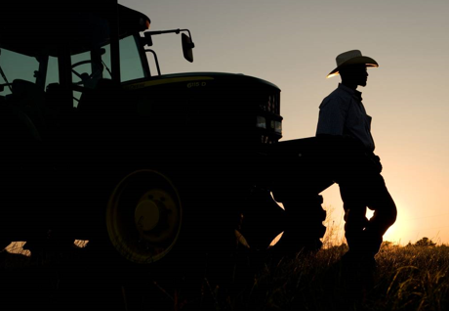
Group Project Title
Agenda:
Collect tweets
Cleanse data
Word map

Slide 2
Sentiment Analysis
While researching text mining we discovered that analysis of the sentiment in text can be very telling.
We compared the words in the tweets with the nrc sentiment lexicon dataset in the tidytext R package and plotted the results.
The sentiment analysis of the Deere tweets were compared to positive, joy, trust, negative, anger and disgust words in the nrc lexicon dataset.
The results showed more positive sentiment in the tweets than negative sentiment.
The greatest number of negative words in the tweets were found when comparing to the anger words in the nrc lexicon. Words lawsuit and court were the most prevalent anger words in the tweets.
Sentiment analysis could be used by Deere marketing to determine the feelings people have about John Deere and their products to help them tailor the focus of marketing strategies.

Slide 3
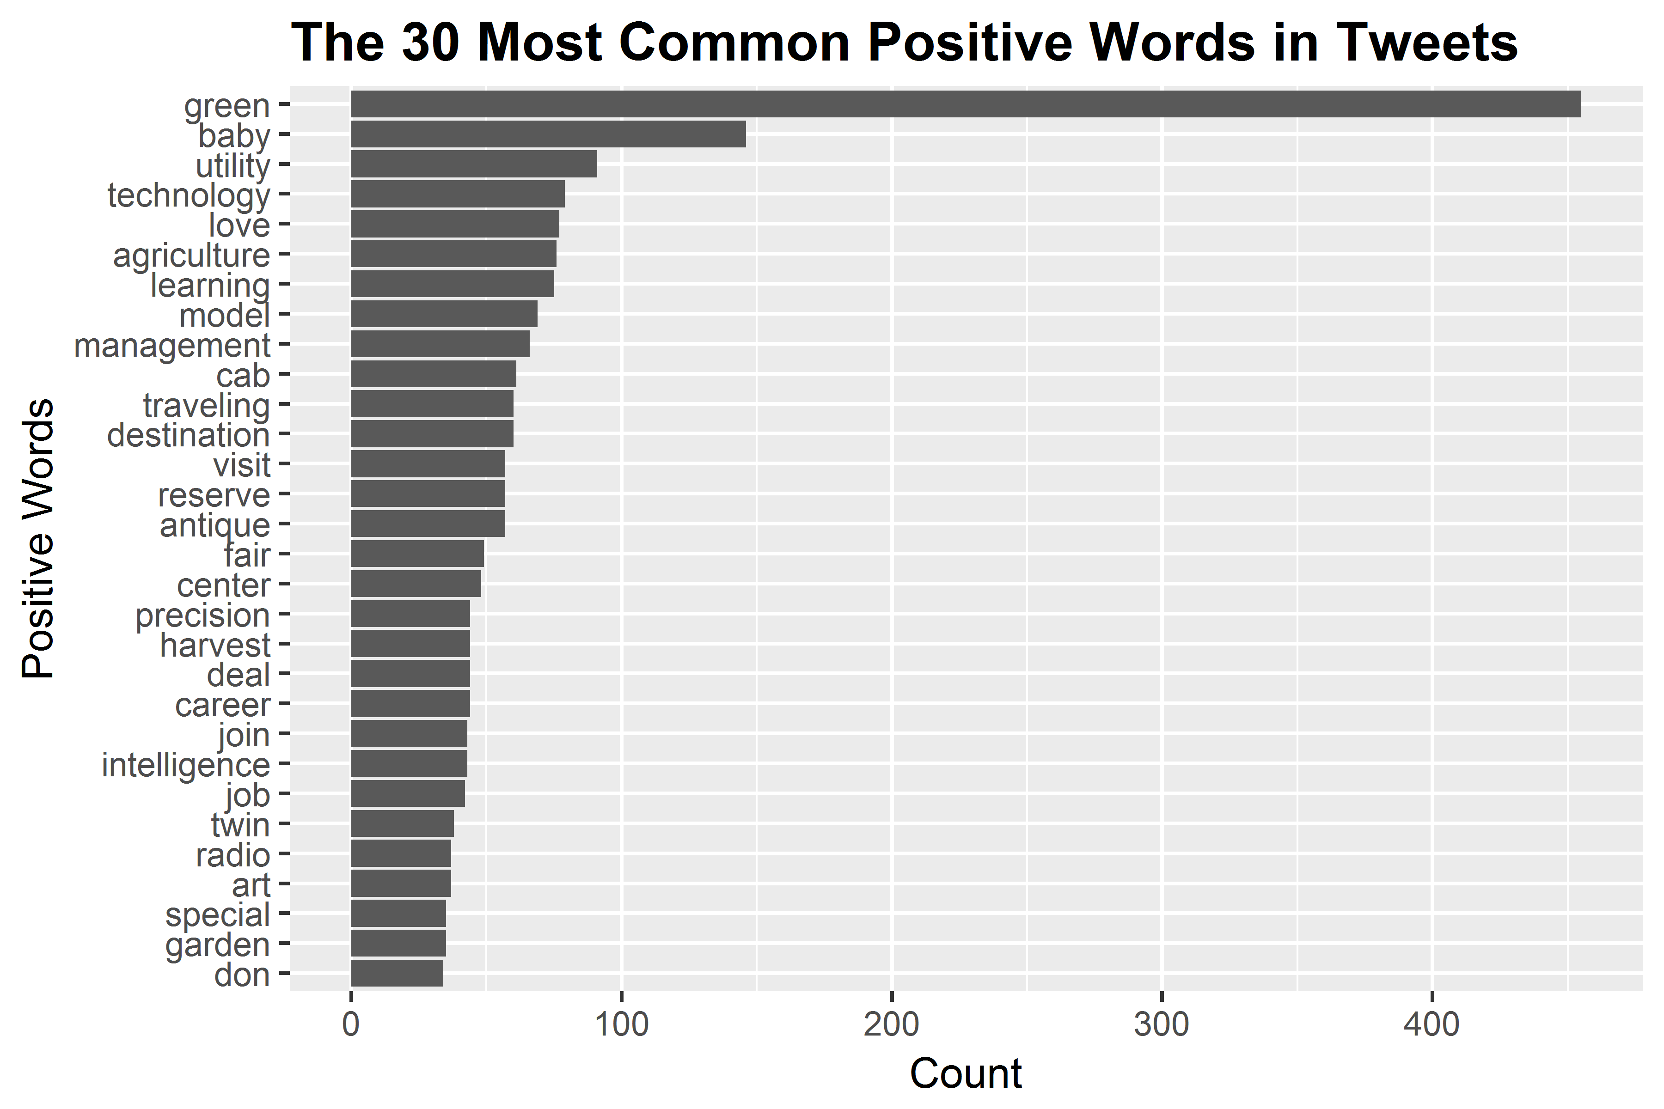
Sentiment Analysis cont.

Slide 4
Date/Time Analysis
xxxxxx

Slide 5
Tweet Date / Time Analysis
The tweet data contains a column that is a date and time stamp indicating when each tweet was created.
We grouped the tweets in 4 hour time blocks and plotted the count of tweets created in those blocks.
We expected there would be more tweets in the middle of the day and in the evening.
Our research has shown that people use Twitter most often from noon to 1:00 PM. Our data aligns with this.
John Deere could use this information to help them determine the best times of the day to advertise.
John Deere could use this information to help them determine the best times of the day to advertise.

Slide 6
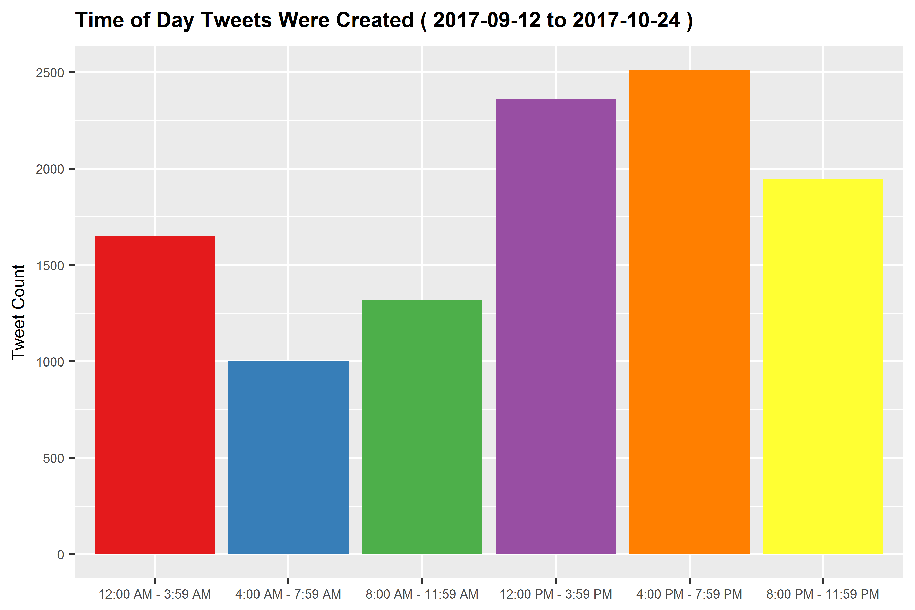
Tweet Date / Time Analysis cont.

Slide 7
Tweet Date / Time Analysis cont.
We also used the date time stamp data to plot the days of the week when people tweet most about John Deere.
We were surprised to see that Wednesday is the day with the greatest number of tweets. We expected most tweets to occur on the weekends.
We researched this and found that Wednesday is the most common day of the week that people tweet.
We wrote a function that takes a date range from the user to plot this data. Users could use this function to see trends in the days of a week that people tweet about John Deere.

Slide 8
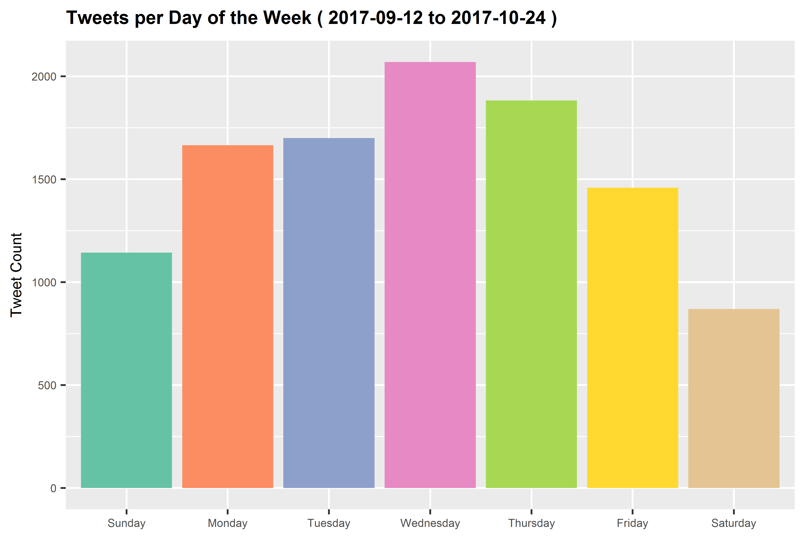
Tweet Date / Time Analysis cont.

Slide 9
Tweet Source Analysis
The source of tweets is one of the columns of the Deere tweet data, e.g. Twitter iPhone app, Twitter Android app, Twitter web page etc.
There are approximately 400 sources that tweets came from in our dataset.
We counted each of the tweet sources and plotted the top 30.
This data could be used by John Deere to target how and where to advertise.

Slide 10
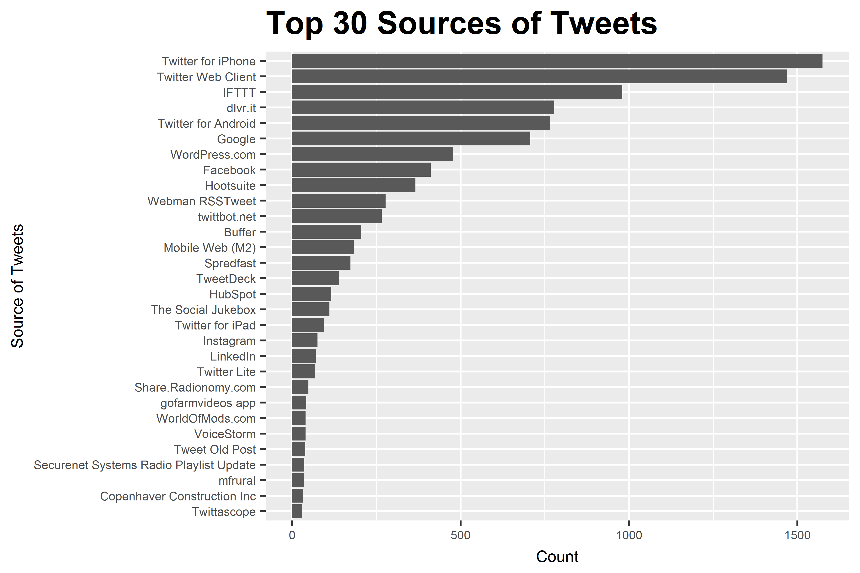
Tweet Source Analysis cont.

Slide 11
Notes:
11

Slide 12

Question and Answer

